Slide 1

CSYE 6200 Daycare project
Chen Ye(002951477) Yanyan Chen(002799697) Jiafang He (002772166) Angie Liu(002706821)
Ge Cheng (002749766) Miaochuan Hu(002922156) Mingxia Li(002765530)

Slide 2
Introduction
The daycare manage system is designed to helps administration identify and manage students in institution.
The project leverages what has been learned in 6200 classrooms: OOD, plant design, packaging, etc.
The project ensure the independence of functions in the file and reduce the coupling between the components. Independent management of administrators and teachers is realized.
Perfect fulfillment of all the requirements of the teacher's task.

Slide 3
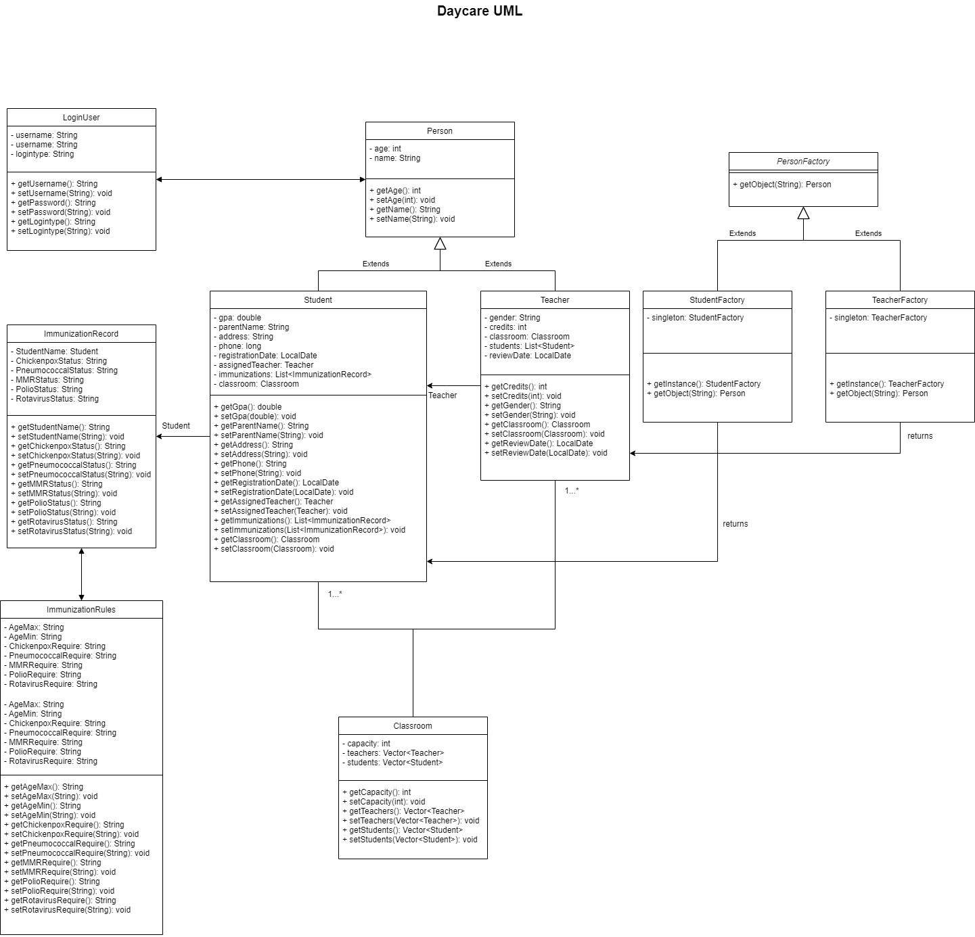
System UML diagram

Slide 4
Tech stack
1
Java-io
Read CSV files and interact with data
2
Java Swing
Create user interface to better interact with users with lightweight GUI component Swing
Factory Design patten
Use factory design patterns to ensure the system is robust, less coupled, and easy to extend
3
4
OOD
Using inheritance, encapsulation, polymorphism, etc., and follow OOD design principles.
5
S.O.L.I.D
Follow S.O.L.I.D design principles to ensure the robustness of the program
6
Exception Handling
Exception handling for program runtime

Slide 5
Two role in system
System Administrator
Add Student
Read and update detailed student info
Registration check
Teacher
Read and update detailed student info
Assign teacher to student
Immunization Tracker
Important data tracker
Classroom check
Registration check
Immunization Tracker
Important data tracker
Classroom check

Slide 6
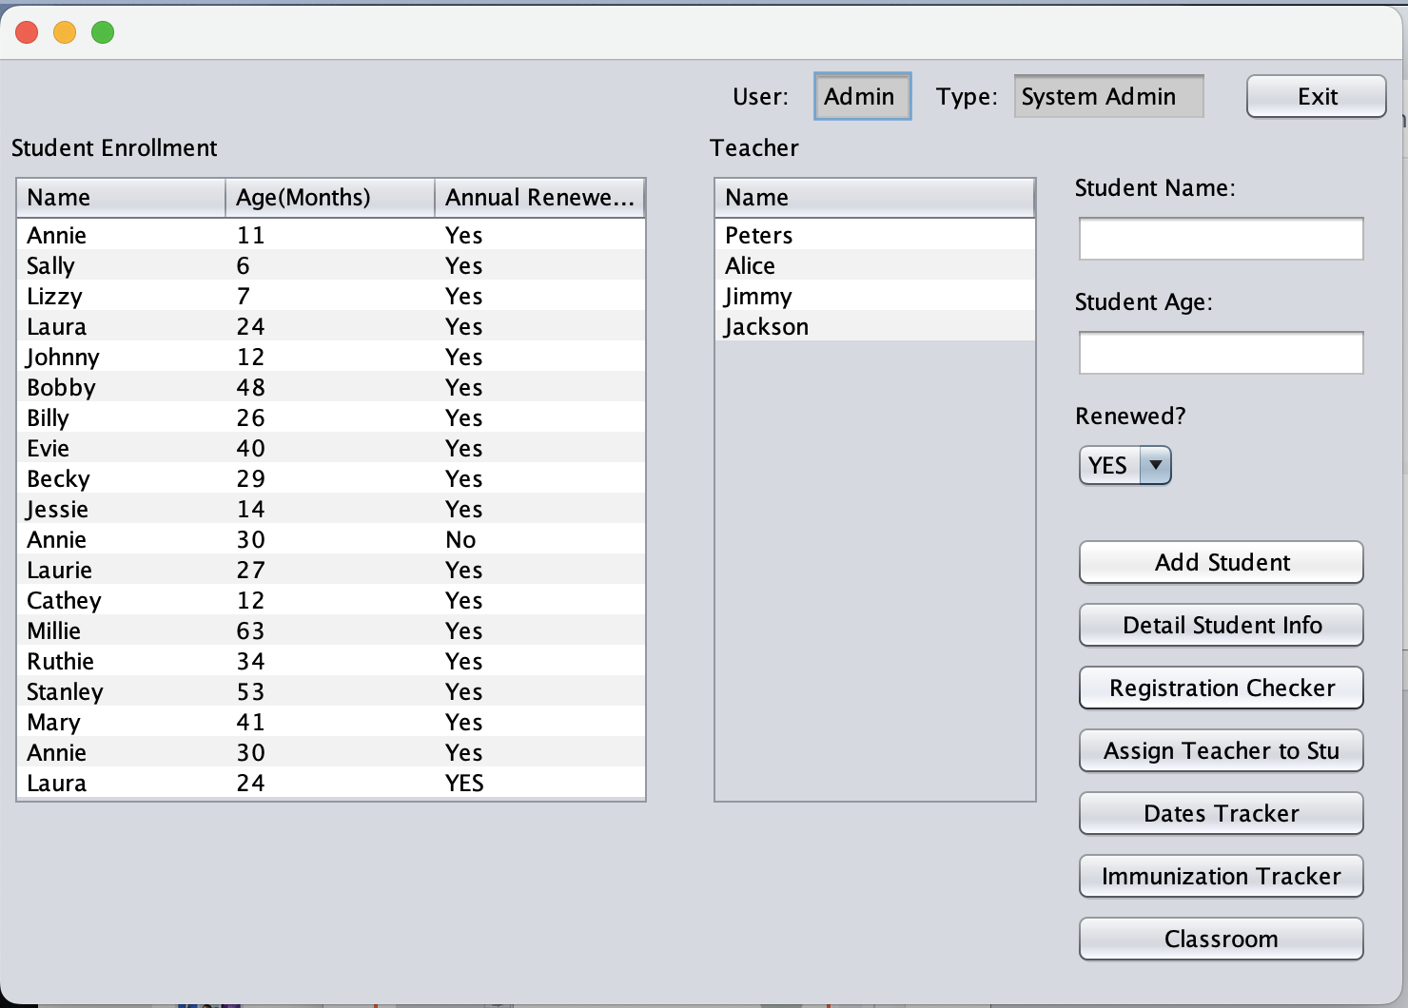
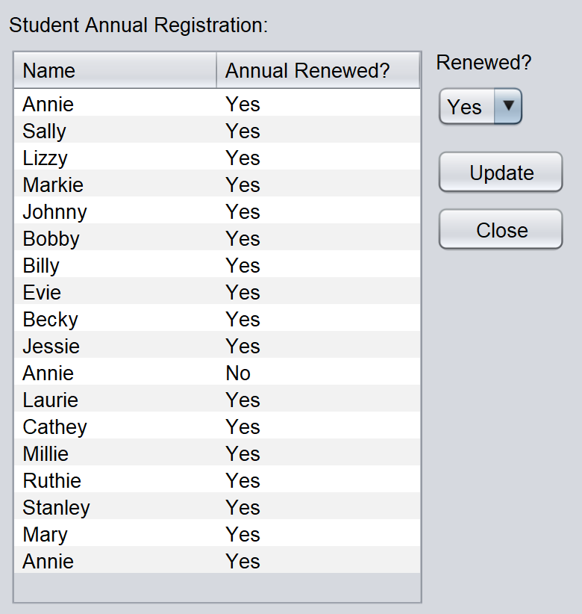
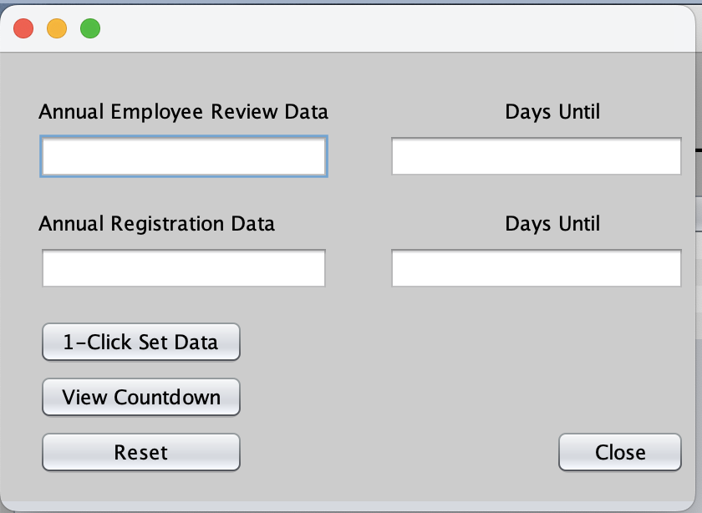
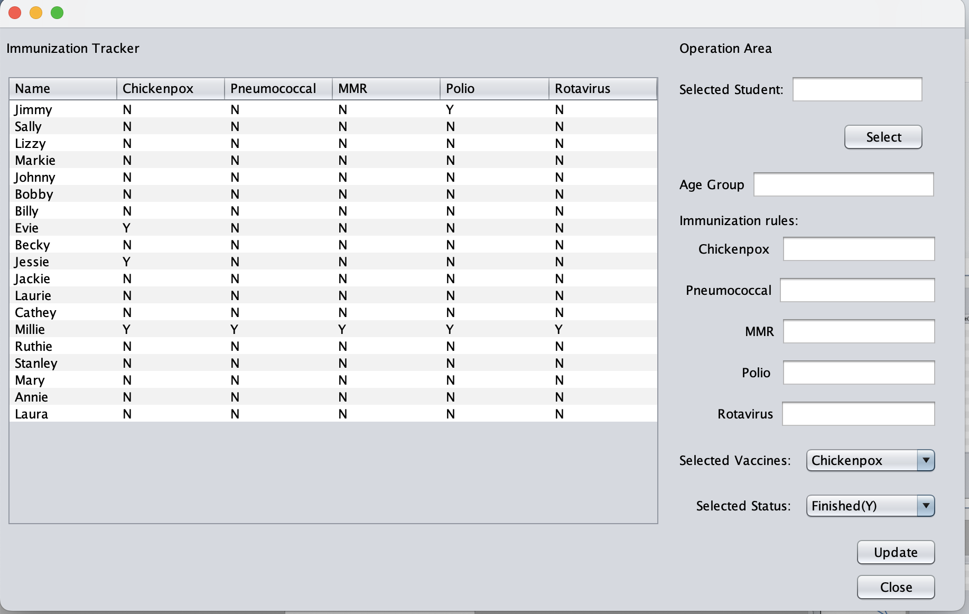
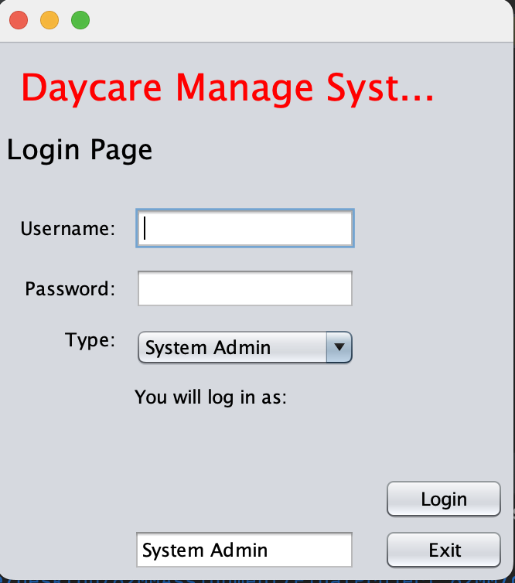
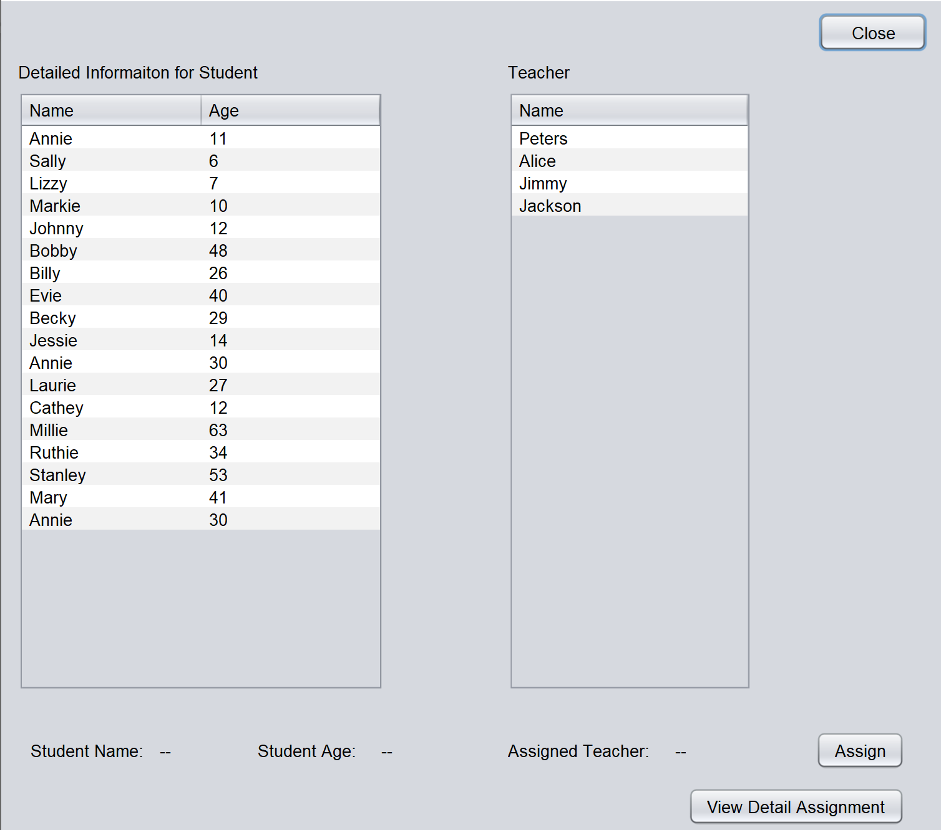
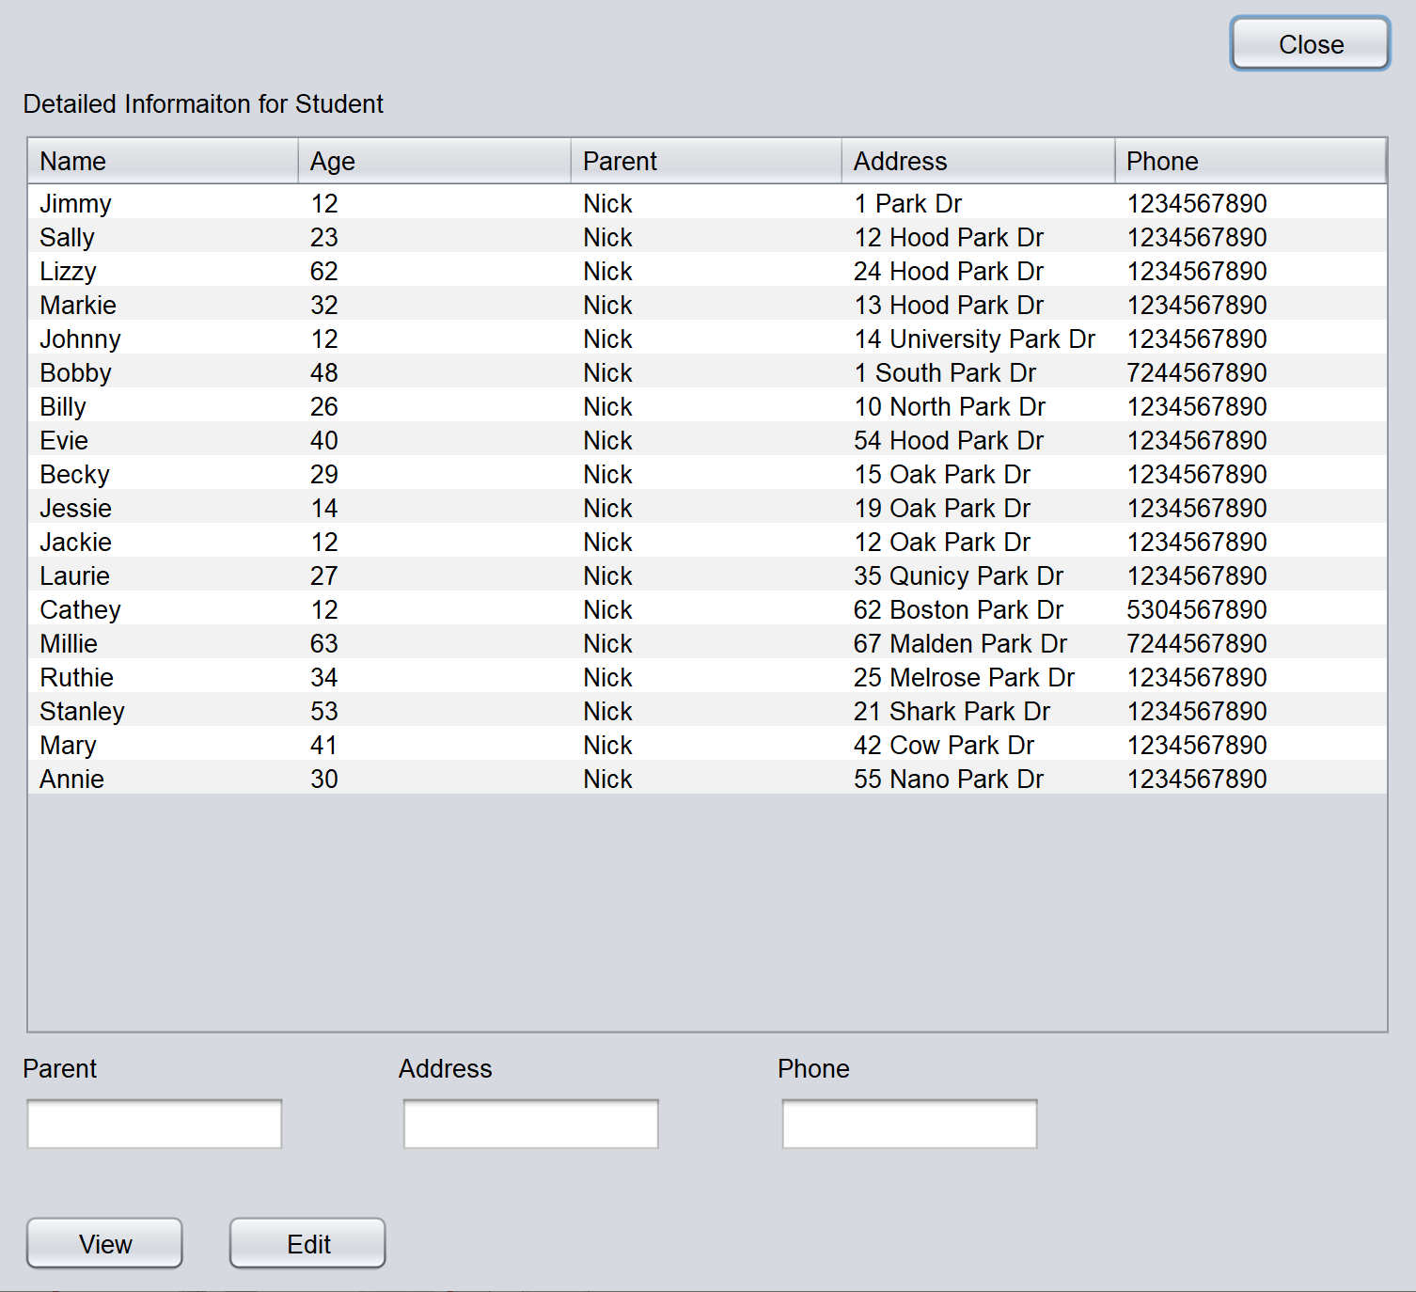
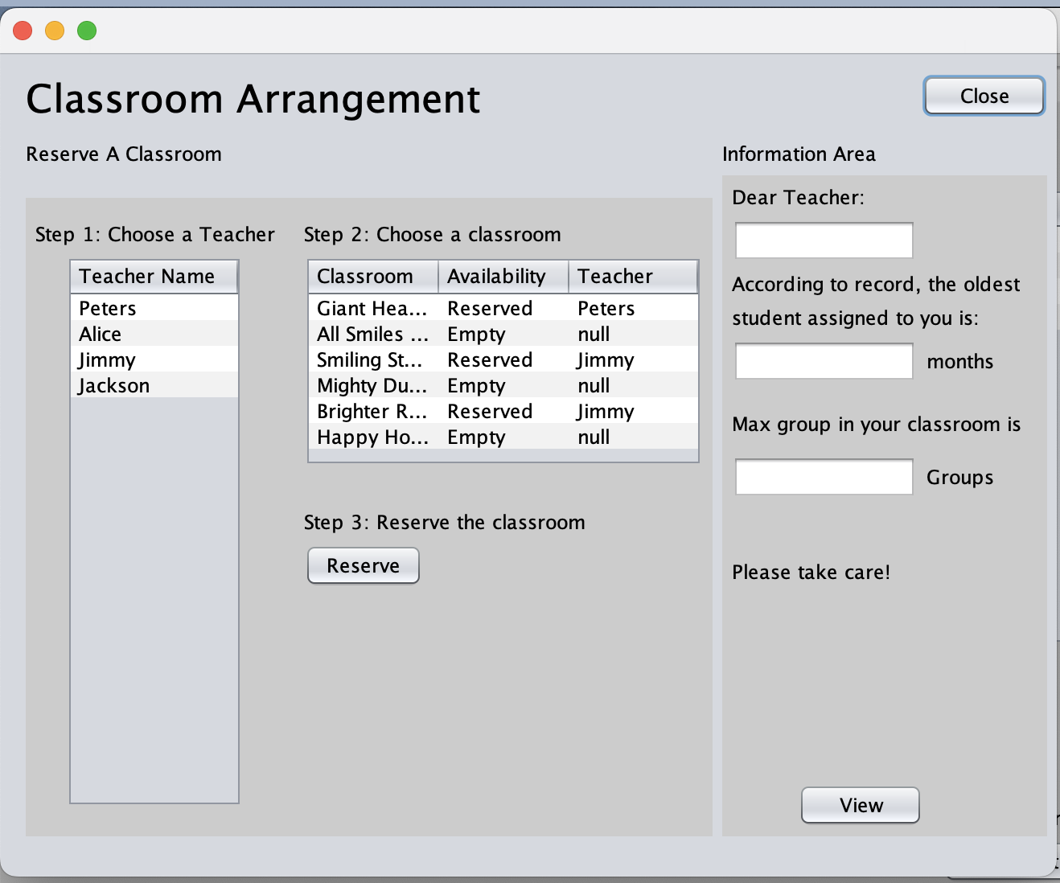
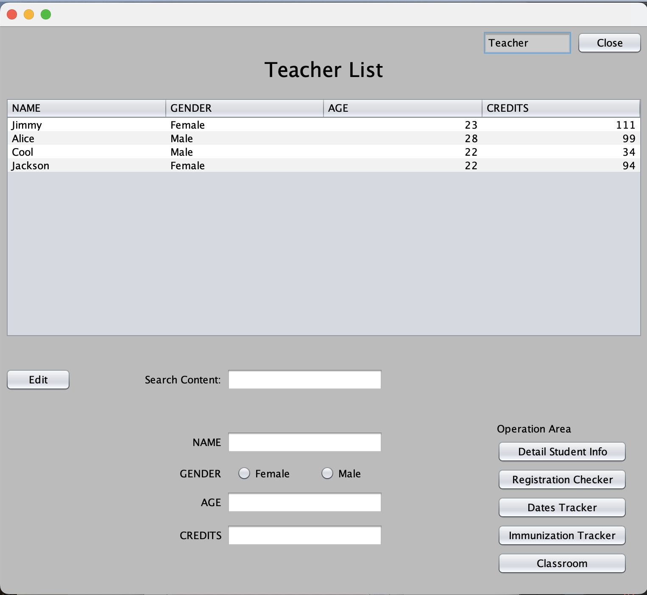
System overview
Main Pages
Functions Pages
Login Page

Slide 7

3-rd party package
OpenCSV
OpenCSV is a simple java class library for parsing CSV files, which encapsulates the read and write operations of CSV format files, automatic mapping of files with java objects, custom delimiters, use escape characters, etc.

Slide 8
Project Future enhance
More Functions
Higher Robustness
More Roles
Better GUI
We can add more functions in the future to achieve the characteristics of perfect system and ease of use.
The system should consider more on handling unexpected termination and unexpected actions.
The system should include more roles, like parent and child, to implement more user case.
GUI can incorporate more UI elements and 3-rd party package to achieve better design language.

Slide 9
Contribution
Yanyan Chen
0027999697
Jiafang He
002772166
Miaochuan Hu
002922156
Mingxia LI
002765530
Chen Ye
002951477
Angie Liu
002706821
Ge Cheng
002749766
add ClassRoom,Person,Student,Teacher model; add assign teacher to student & detail assign feature; add logic of Student to Teacher Ratio Rule & fix bugs; extract Student to Teacher Ratio Rule from DayCareRatio.csv in Detail Assign JFrame
Create and imply the UI to read/update student's annual registration.
Implement the system admin page, student immunization tracker, system login module, csv file read and write module, assigning student/teacher group to classroom function, and annual employee review/registration tracker alert module. System integration.
Create and imply the UI to read/update student's detail information(name, address, phone)
Unit test the system, debug. Improve the content of the job submission. Make project PPT
draw
Daycare uml
Create and imply the UI to read/update teacher's detail; write model.student, model.teacher, factory classes; draw daycare-uml

Slide 10
Reference
1.https://docs.oracle.com/en/java/
2.https://docs.oracle.com/javase/7/docs/api/java/awt/package-summary.html3.https://expressjs.com/en/5x/api.html
4.https://www.javatpoint.com/java-swing
5.https://www.tutorialspoint.com/design_pattern/factory_pattern.htm
6.https://stackify.com/solid-design-principles/
7.https://developer.mozilla.org/en-US/docs/Glossary/MVC
8.https://docs.github.com/en
9.https://www.seas.upenn.edu/~cis1xx/resources/java/fileIO/introToFileIO.html
10.https://www.baeldung.com/java-csv
11.https://opencsv.sourceforge.net
12.https://www.baeldung.com/opencsv
13.https://www.simplilearn.com/tutorials/java-tutorial/thread-in-java
15.https://www.edureka.co/blog/java-jframe/
16.https://www.digitalocean.com/community/conceptual-articles/s-o-l-i-d-the-first-five-principles-of-object-oriented-design
17.https://www.collinsdictionary.com/us/dictionary/english/ood18.
19.https://www.geeksforgeeks.org/runnable-interface-in-java/
20.https://docs.oracle.com/javase/tutorial/java/javaOO/lambdaexpressions.html

Slide 11

Thank You

